Slide 1


Slide 2
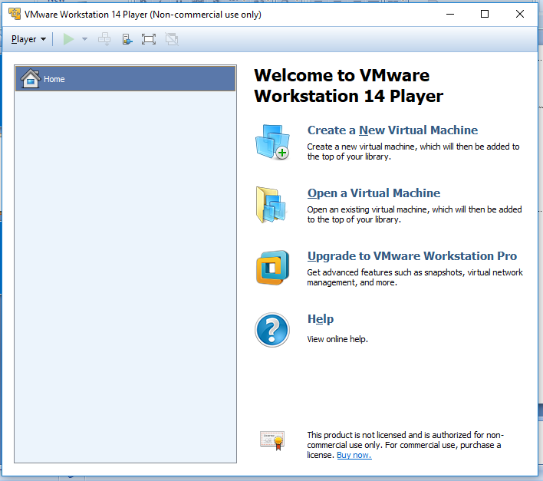
VMware
Home Screen
Adding a new VM
Open existing VM
License Key Upgradation

Slide 3
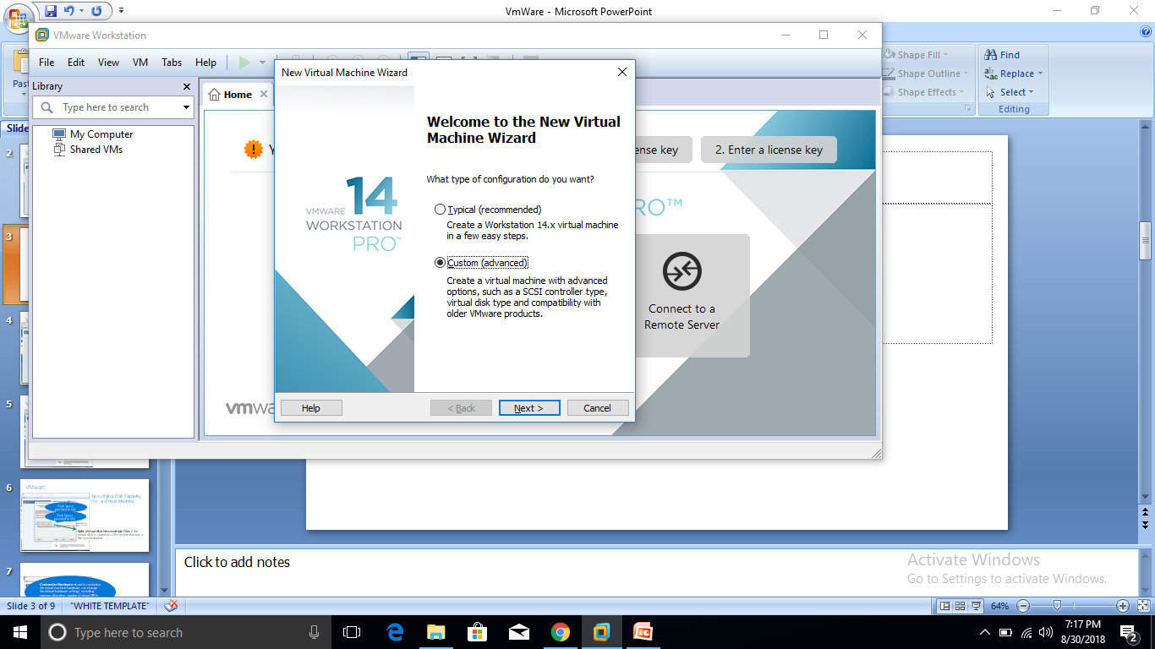
VMware
Will not ask you anything.. Will simply install
The user need to specify every single detail.

Slide 4
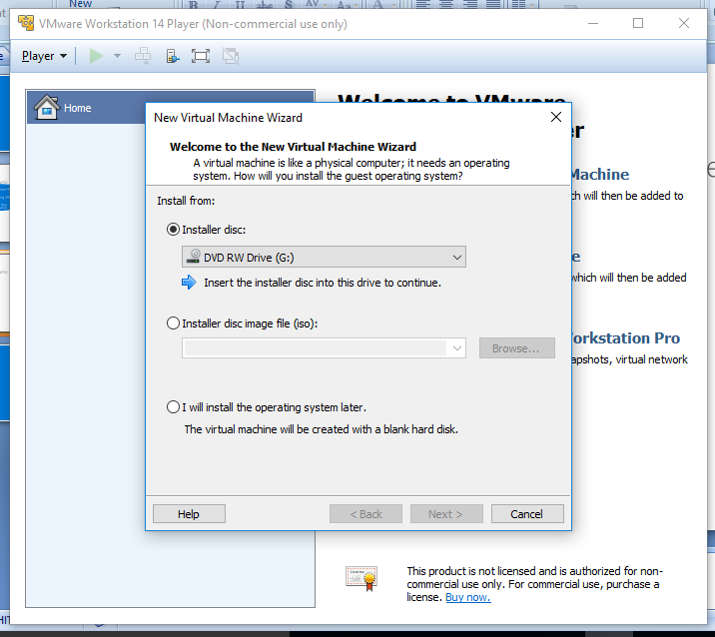
VMware
Adding Image
From CD
iso image on HDD
No image.. Blank partition would be created

Slide 5
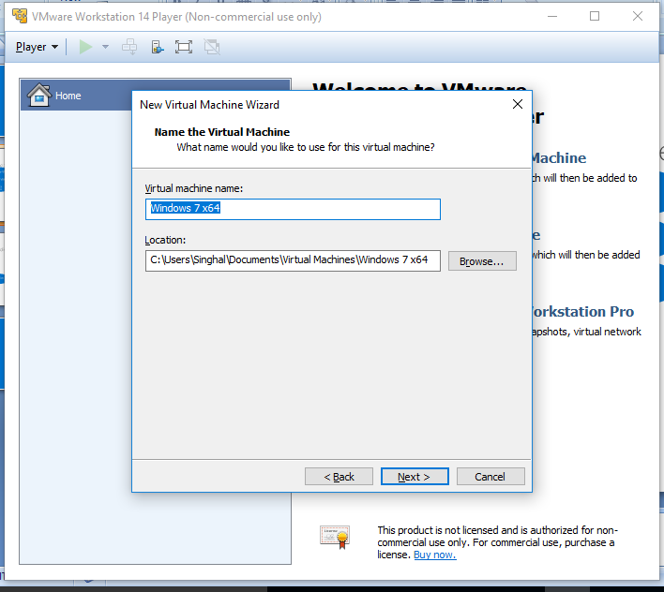
VMware
Adding Windows Image
Name of VM
Location of VM

Slide 6
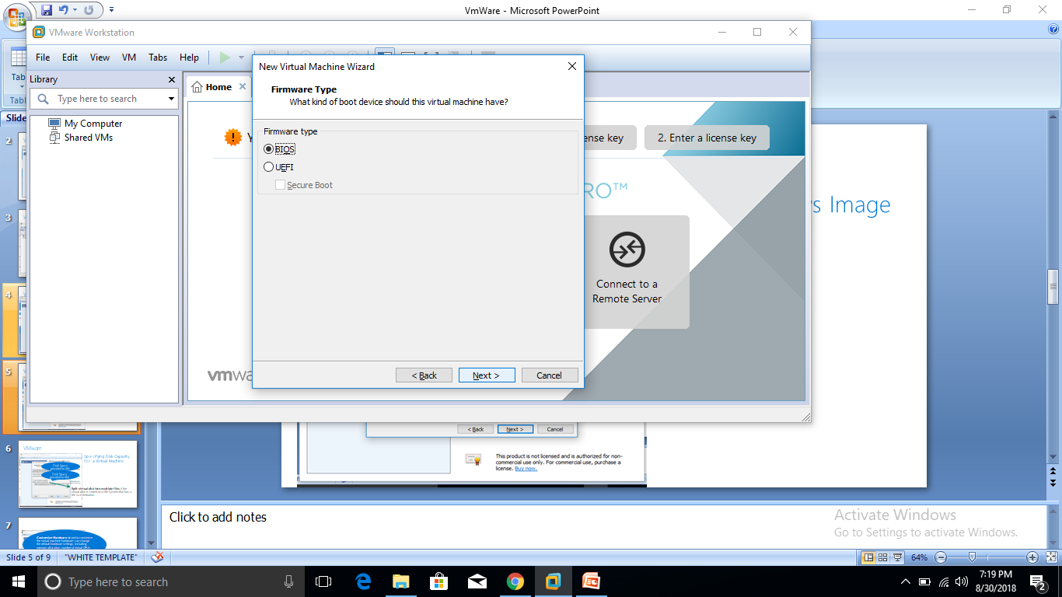
Vmware: Firmware Setting
Decide what kind of boot option you want?
Basic Input/Output System
Or
Unified Extensible Firmware Interface (UEFI)
Do I need a host with EFI firmware?
NO
Advantage:
It's the way of the future
Boot from >2TB volumes
UEFI knows about filesystems

Slide 7
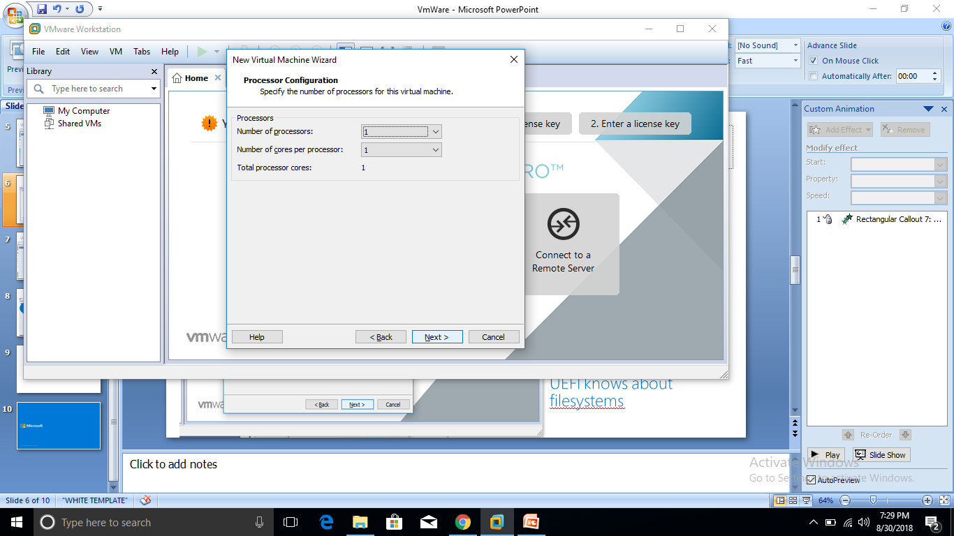
Vmware: Processor Setting
As per your requirement and system configuration, assign the processors and cores to the VM

Slide 8
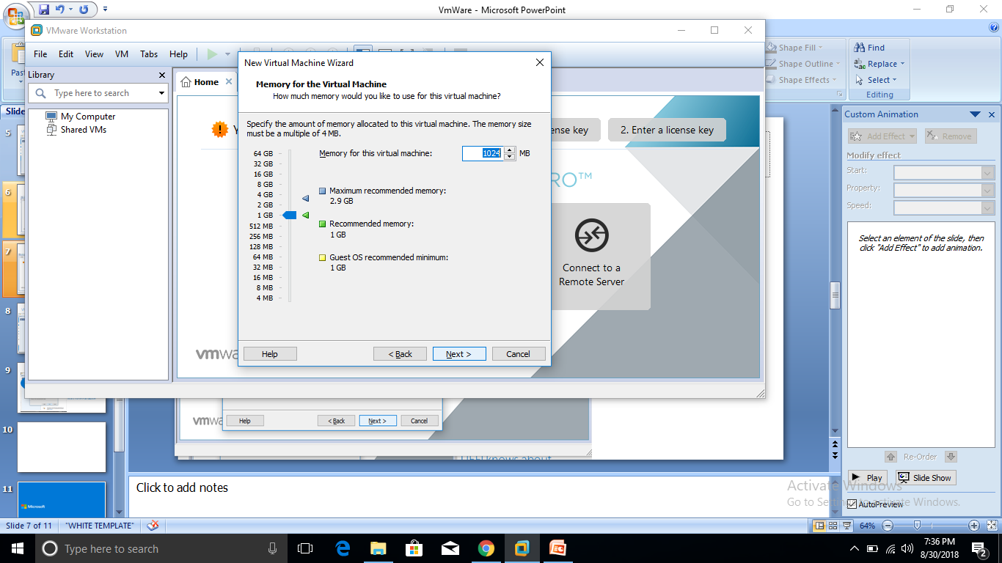
Vmware: Memory Setting
As per your requirement and system configuration, assign the memory for the VM

Slide 9
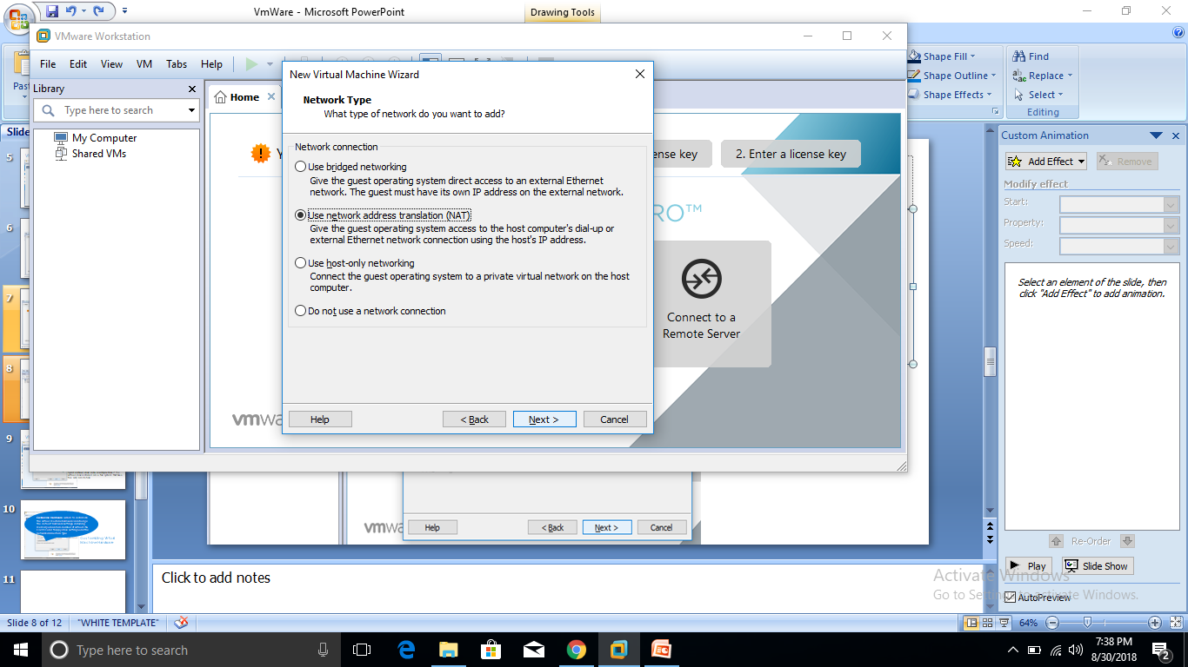
Vmware: Network Setting
If you are creating a remote virtual machine, you must select either a custom network or no network connection.

Slide 10
Vmware: Network Setting
Use bridged networking | With bridged networking, the virtual machine has direct access to an external Ethernet network. The virtual machine must have its own IP address on the external network.
Use network address translation (NAT) | With NAT, the virtual machine and the host system share a single network identity that is not visible outside the network.
Use host-only networking | Host-only networking provides a network connection between the virtual machine and the host system, using a virtual network adapter that is visible to the host operating system.
Do not use a network connection | Do not configure a network connection for the virtual machine.

Slide 11
Vmware: Network Setting
Use bridged networking | If your host system is on a network and you have a separate IP address for your virtual machine
Use network address translation (NAT) | Select NAT if you do not have a separate IP address for the virtual machine, but you want to be able to connect to the Internet.
Use host-only networking | With host-only networking, the virtual machine can communicate only with the host system and other virtual machines in the host-only network. Select host-only networking to set up an isolated virtual network.

Slide 12
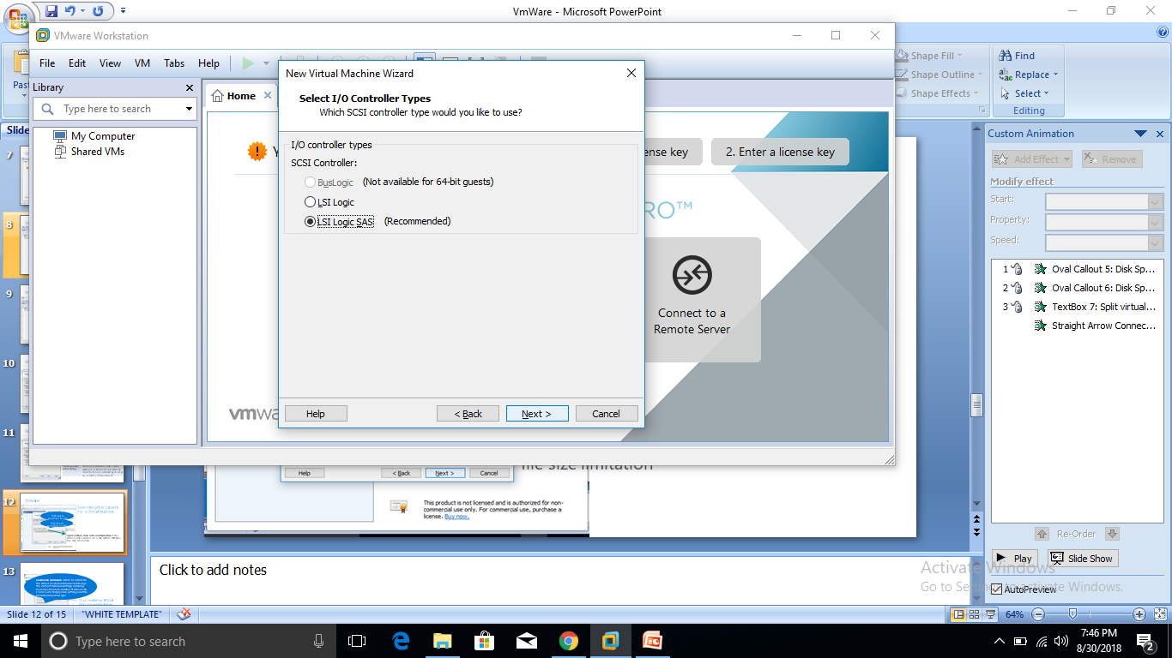
Vmware: I/O Controller
BusLogic and LSI Logic adapters have parallel interfaces.
The LSI Logic SAS adapter has a serial interface

Slide 13
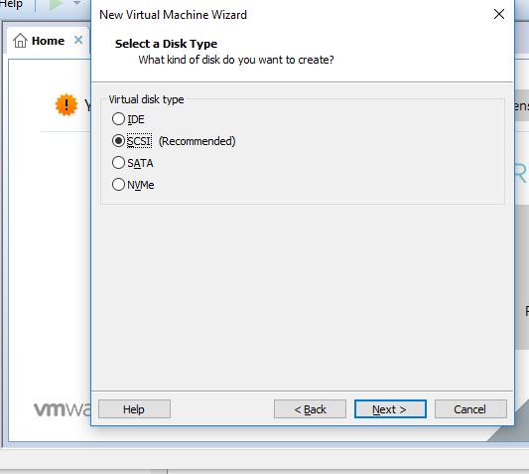
Vmware: Disk Type
You can set up a virtual disk as an IDE disk for any guest operating system.
You can set up a virtual disk as a SCSI disk for any guest operating system that has a driver for the LSI Logic or BusLogic SCSI controller available in the virtual machine.

Slide 14
Vmware: Disk Type
Option | Description
IDE | Create an IDE device. You can add up to four IDE devices to a virtual machine.
SCSI | Create a SCSI device. You can add up to 60 SCSI devices to a virtual machine.
SATA | Create a SATA device. You can add up to 120 SATA devices, four controllers, and 30 devices per controller
NVMe | Non Volatile Memory Express Create an NVMe device. You can add up to 60 NVMe devices, four controllers, and 15 devices per controller.

Slide 15
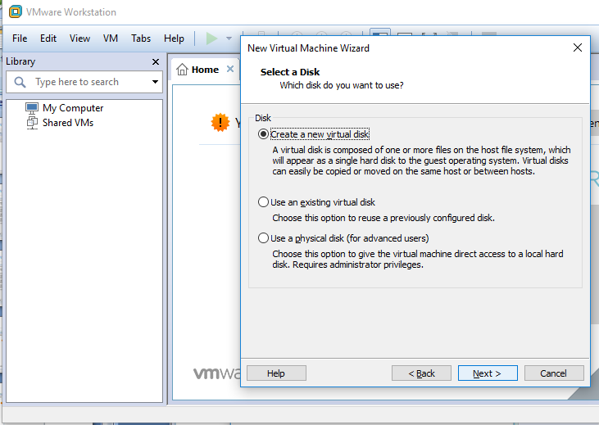
Vmware: Disk Type
Allocate memory to the VM. Depending upon your need and system requirement select the option.

Slide 16
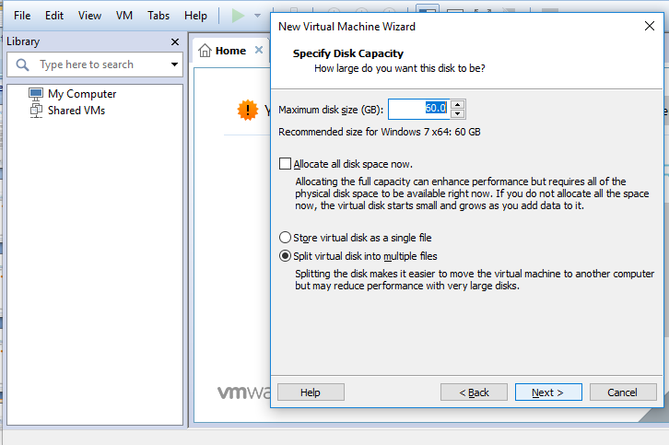
Vmware: Disk Capacity
If size is exceeding the limit, select split option.

Slide 17
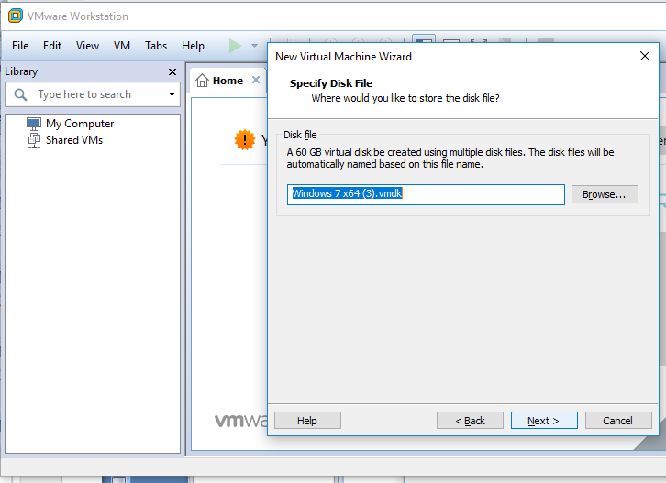
Vmware: Disk Type

Slide 18
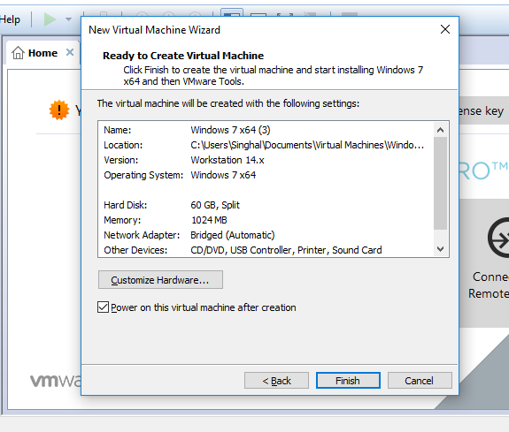
Vmware: Customization
Change the default hardware settings, including memory allocation, number of virtual CPUs, CD/DVD and floppy drive settings, and the network connection type.

